Slide 1


Jolly Phonics Automaticity Cards
By Alexandria’s World

Slide 2
Directions
Automaticity is a great center to have for students in order to practice letter sound fluency. This is a ready to go center for you to use throughout the year. These cards are meant for students to have letter sound fluency, blending fluency and word practice. Scholars start to read in no time. Sound practice is in Jolly Phonics set order. Book 1: S, A, T, I, P, N Book 2: CK, E, R, H, M, D Book 3: G, O, U, L, B, F
Other Sounds: J, W, Z, Y, Qu, V, X (My district uses Reach for Reading Series and the cards work fine with the series.)
Very simple set-up. Cut each page in half, place on card stock paper, and laminate.
After teaching Book 1 Sounds, introduce the Book 1 sound cards.
When students can say the sounds in a solid rhythm, move them to the blending cards.
After smoothly blending their sounds into words, move them to the word cards.
Key to success is persistence. I grill them on these cards during reading groups sometimes so they know what to work on when they are alone.

Slide 3
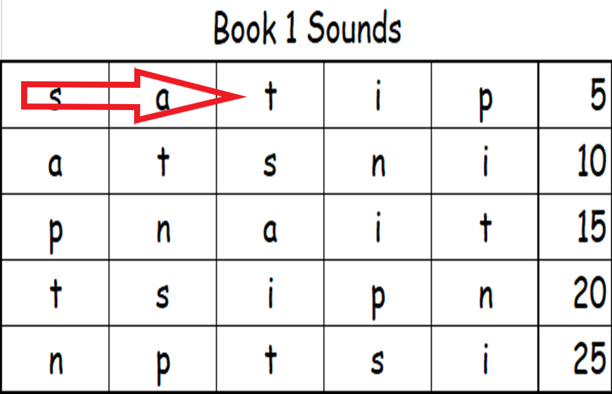
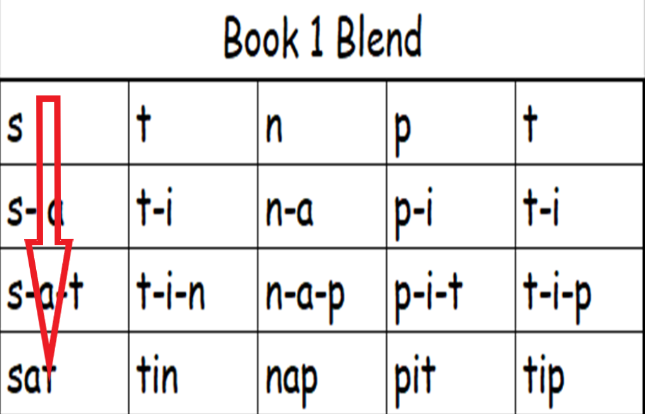
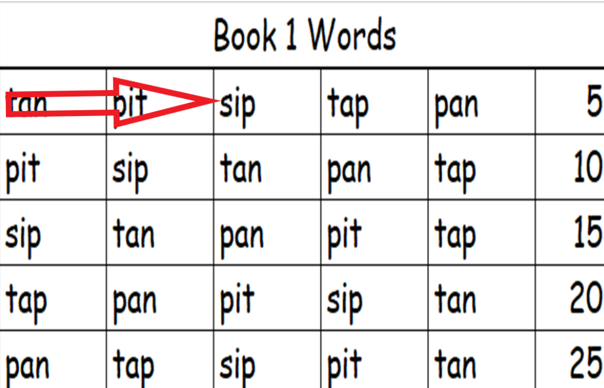
Directions
Read SOUND cards left to right
Read BLEND cards top to bottom
Read WORD cards left to right

Slide 4
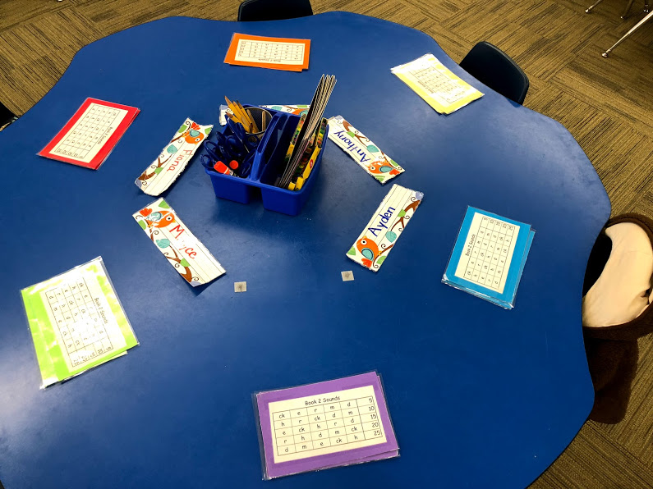
It’s really this simple! Resource teachers, use this activity to get your kids reading quickly.
Kindy teachers, use this activity to solidify those letter sounds and get your students blending fast!

Slide 5

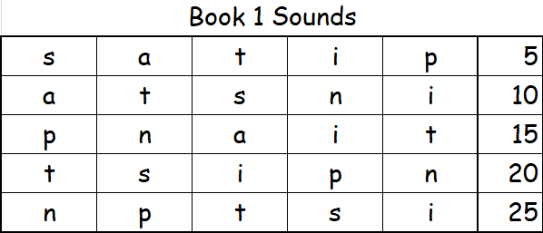
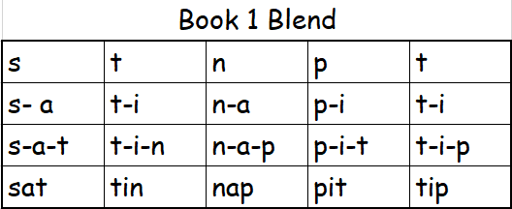

Slide 6
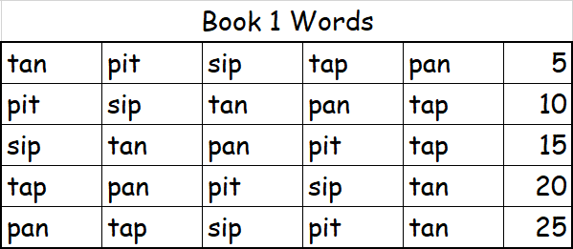
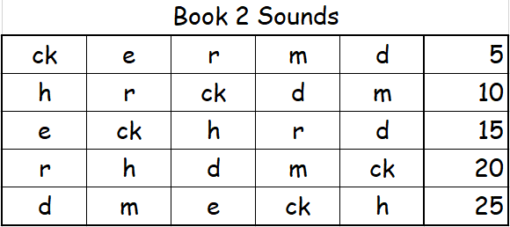

Slide 7
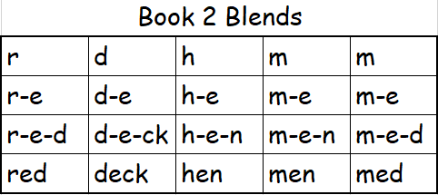
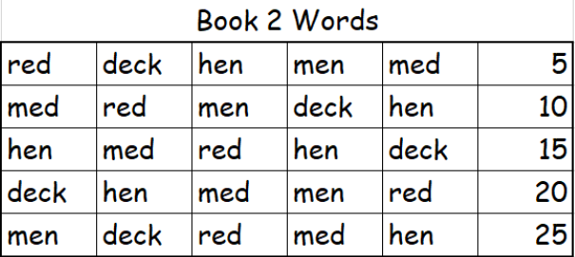

Slide 8
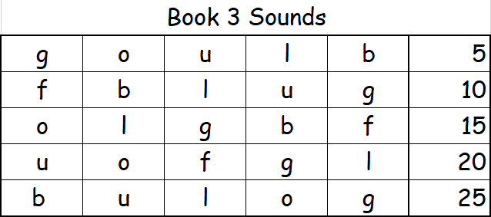
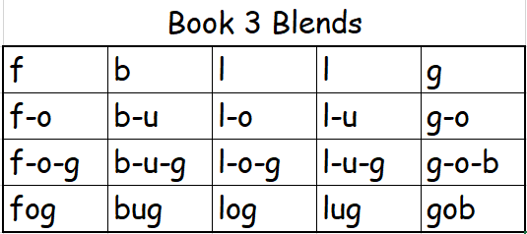

Slide 9
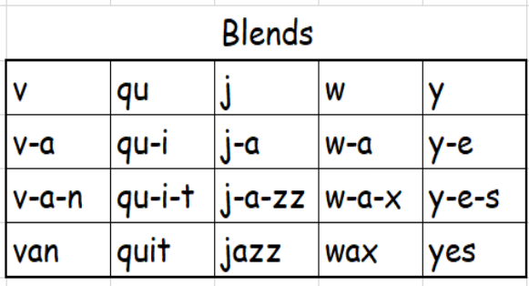
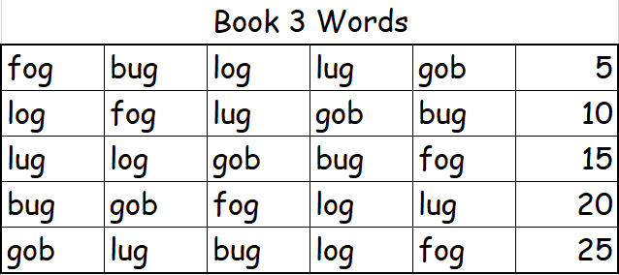
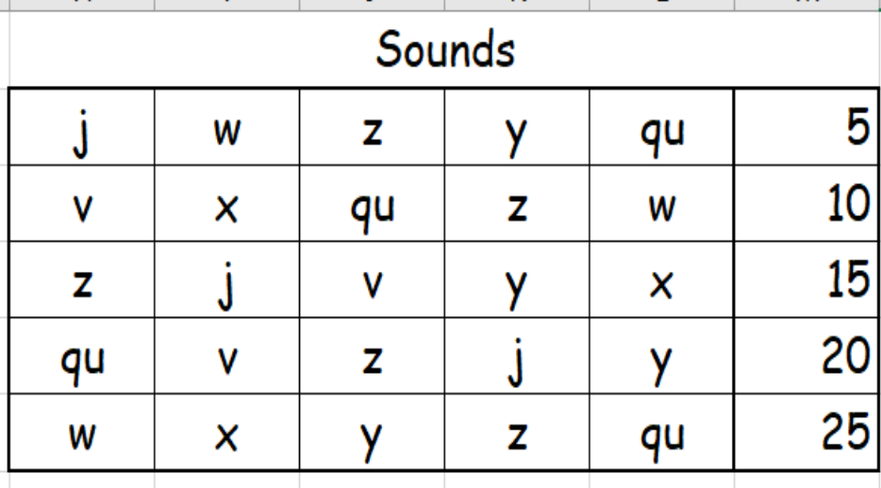
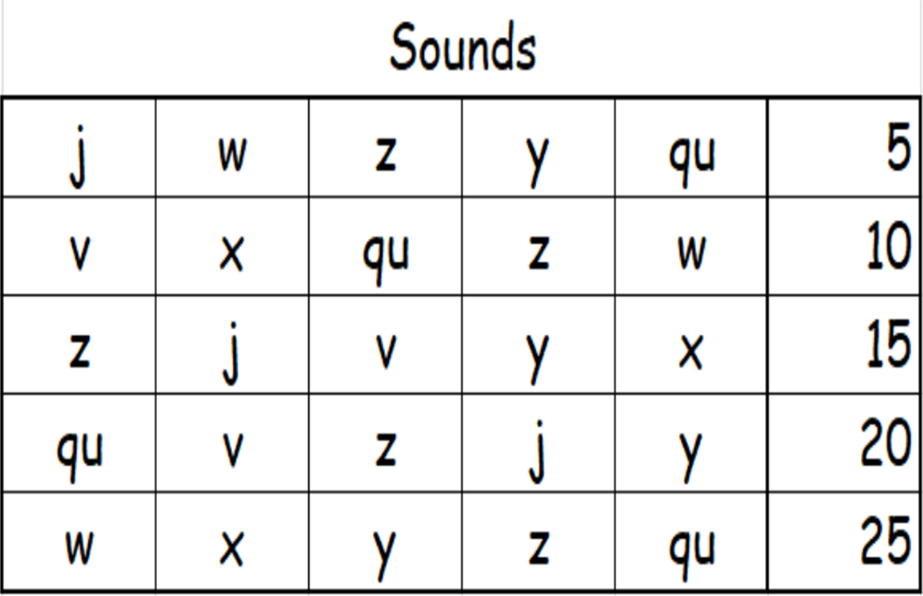

Slide 10
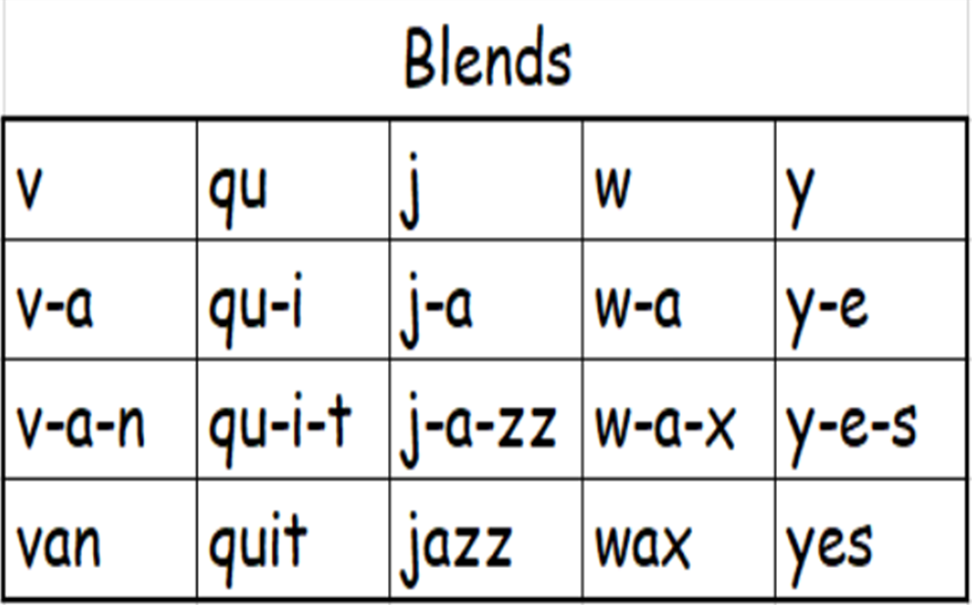
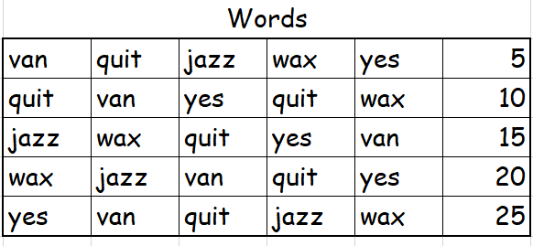

Slide 11



Slide 17


Slide 23


Slide 35


Slide 41




Terms of Use
Welcome to Alexandria’s World. Our mission is to give kids access to the world around us. We are here to share our content with you freely. Please feel free to use in your classroom and spread the word. Please leave us a review on our site. Visit us for more products on culture / travel at our website: www.alexandriasworld.com
Special thanks to the following creatives that helped us create our product:

